Slide 1
Module 5: Threads
Benefits
User and Kernel Threads
Multithreading Models
Solaris 2 Threads
Java Threads

Slide 2
Benefits
Responsiveness
Resource Sharing
Economy
Utilization of MP Architectures

Slide 3
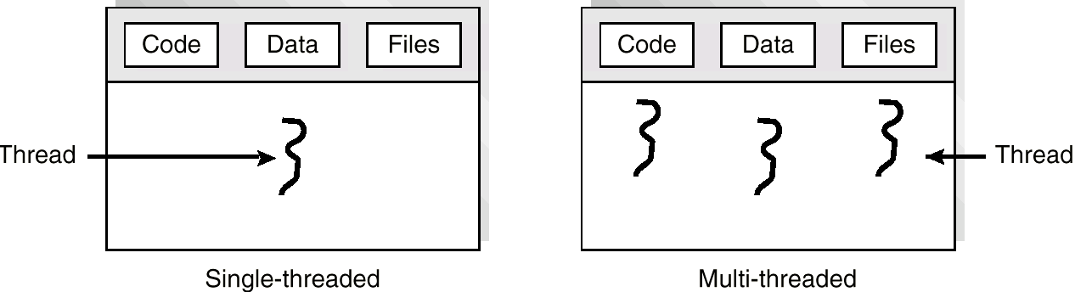
Single and Multithreaded Processes

Slide 4
User Threads
Thread Management Done by User-Level Threads Library
Examples
- POSIX Pthreads
- Mach C-threads
- Solaris threads

Slide 5
Kernel Threads
Supported by the Kernel
Examples
- Windows 95/98/NT
- Solaris
- Digital UNIX

Slide 6
Multithreading Models
Many-to-One
One-to-One
Many-to-Many

Slide 7
Many-to-One
Many User-Level Threads Mapped to Single Kernel Thread.
Used on Systems That Do Not Support Kernel Threads.

Slide 8
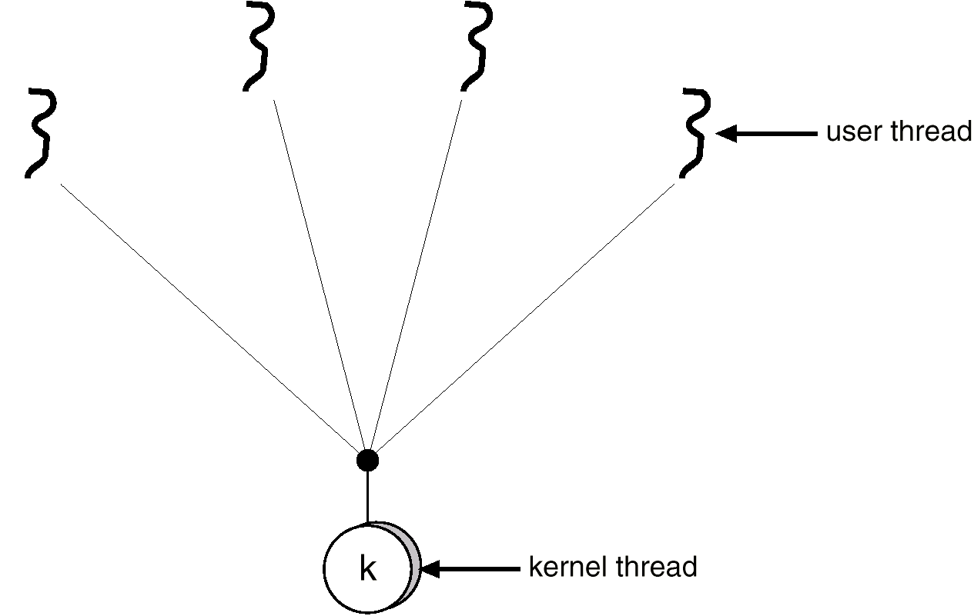
Many-to-one Model

Slide 9
One-to-One
Each User-Level Thread Maps to Kernel Thread.
Examples
- Windows 95/98/NT
- OS/2

Slide 10
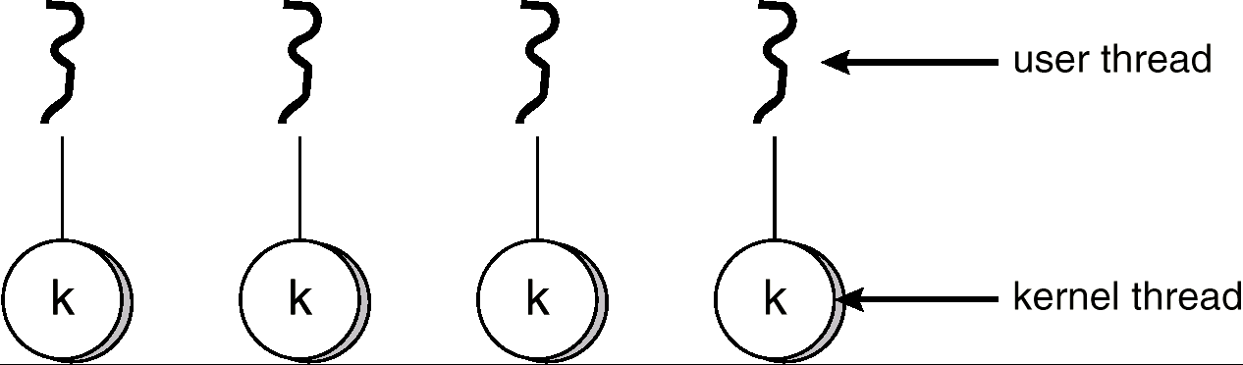
One-to-one Model

Slide 11
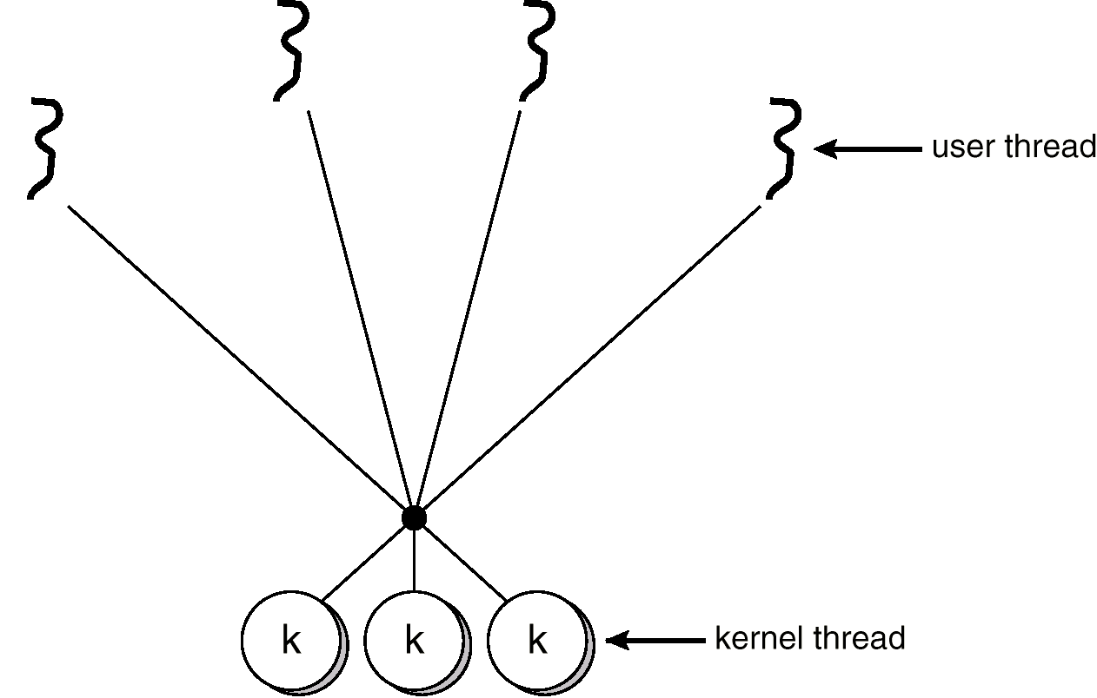
Many-to-many Model

Slide 12

Solaris 2 Threads

Slide 13

Solaris Process

Slide 14
Java Threads
Java Threads May be Created by:
  Extending Thread class
  Implementing the Runnable interface

Slide 15
Extending the Thread Class
class Worker1 extends Thread
{
public void run() {
System.out.println(“I am a Worker Thread”);
}
}

Slide 16
Creating the Thread
public class First
{
public static void main(String args[]) {
Worker runner = new Worker1();
runner.start();
System.out.println(“I am the main thread”);
}
}

Slide 17
The Runnable Interface
public interface Runnable
{
public abstract void run();
}

Slide 18
Implementing the Runnable Interface
class Worker2 implements Runnable
{
public void run() {
System.out.println(“I am a Worker Thread”);
}
}

Slide 19
Creating the Thread
public class Second
{
public static void main(String args[]) {
Runnable runner = new Worker2();
Thread thrd = new Thread(runner);
thrd.start();
System.out.println(“I am the main thread”);
}
}

Slide 20
Java Thread Management
suspend() – suspends execution of the currently running thread.
sleep() – puts the currently running thread to sleep for a specified amount of time.
resume() – resumes execution of a suspended thread.
stop() – stops execution of a thread.

Slide 21

Java Thread States

Slide 22
Producer Consumer Problem
public class Server {
public Server() {
MessageQueue mailBox = new MessageQueue();
Producer producerThread = new Producer(mailBox);
Consumer consumerThread = new Consumer(mailBox);
producerThread.start();
consumerThread.start();
}
public static void main(String args[]) {
Server server = new Server();
}
}

Slide 23
Producer Thread
class Producer extends Thread {
public Producer(MessageQueue m) {
mbox = m;
}
public void run() {
while (true) {
// produce an item & enter it into the buffer
Date message = new Date();
mbox.send(message);
}
}
private MessageQueue mbox;
}

Slide 24
Consumer Thread
class Consumer extends Thread {
public Consumer(MessageQueue m) {
mbox = m;
}
public void run() {
while (true) {
Date message = (Date)mbox.receive();
if (message != null)
// consume the message
}
}
private MessageQueue mbox;
}

